Slide 1
NATIONAL HISPANIC HERITAGE MONTH
HISPANICS: A LEGACY OF HISTORY, A PRESENT OF ACTION AND A FUTURE OF SUCCESS
September 15–October 15, 2020

Slide 2

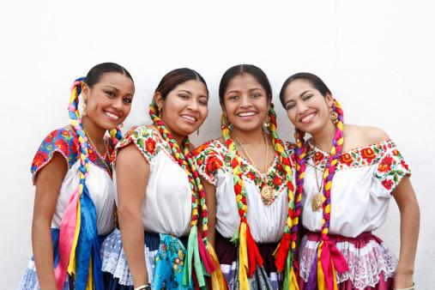
National Hispanic Heritage Month
2
Each year, we observe National Hispanic Heritage Month from September 15th to October 15th, celebrating the histories, cultures, and contributions of American citizens with ancestors from Spain, Mexico, the Caribbean, and Central and South America.

Slide 3
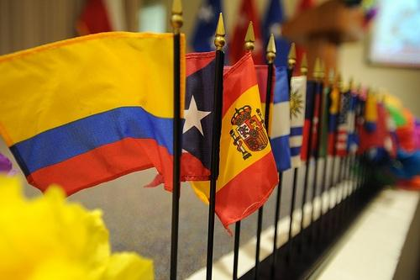
National Hispanic Heritage Month
3
September 15th is the anniversary of independence for Costa Rica, El Salvador, Guatemala, Honduras, and Nicaragua.
Mexico declared its independence on September 16th, and Chile on September 18th. Columbus Day is recognized on October 12th.

Slide 4
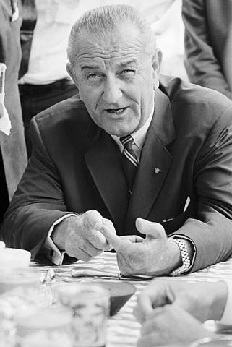
National Hispanic Heritage Month
4
The observance started in September 1968 as Hispanic Heritage Week under President Lyndon B. Johnson.
In 1970, the Hispanic population of the United States was 9.6 million, constituting 4.7 percent of the nation's total population.
Photo courtesy of
the White House

Slide 5
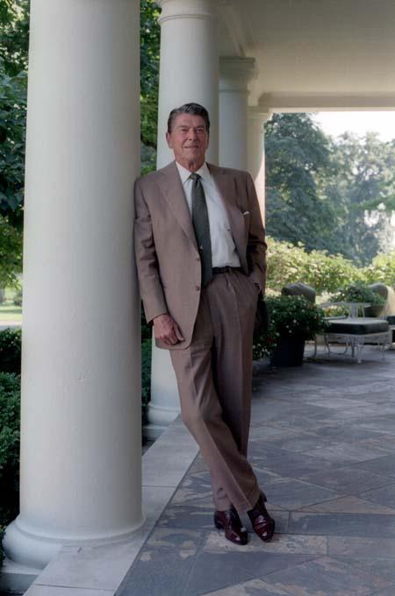
National Hispanic Heritage Month
5
In 1988, President Ronald Reagan expanded the length of the observance, establishing Hispanic Heritage Month.
The Hispanic population that same year was 19.4 million, roughly 7.9 percent of the nation’s total population.
Photo courtesy of the Ronald Reagan Library

Slide 6

National Hispanic Heritage Month
6
Between July 1, 2011, and July 1, 2012, the number of Hispanics in America rose by 1.1 million.
This number is nearly half of the approximately 2.3 million people added to the nation's population during this period.

Slide 7

National Hispanic Heritage Month
7
Data from the 2010 Census provide insights to our ethnically diverse nation. According to the 2010 Census, 308.7 million people resided in the United States on April 1, 2010, of which 50.5 million (or 16 percent) were of Hispanic or Latino origin (see Table 1). The Hispanic population increased from 35.3 million in 2000 when this group made up 13 percent of the total population.

Slide 8

National Hispanic Heritage Month
8
In 2060, the projected Hispanic population of the U.S. will be 128.8 million. According to this projection, Hispanics will constitute 31 percent of the nation's population.

Slide 9
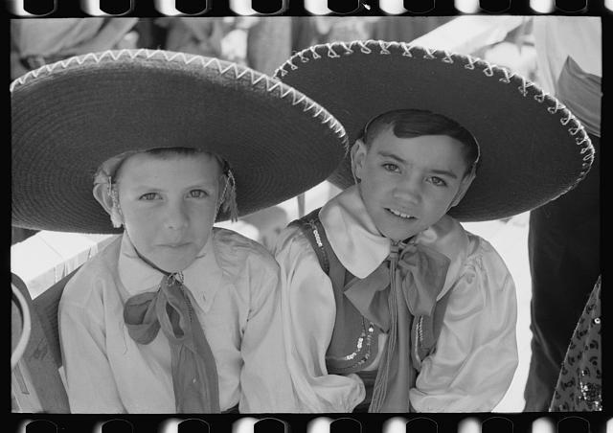
National Hispanic Heritage Month
9
Generations of Hispanics have enriched every facet of our national identity, with traditions that reflect many diverse Hispanic/Latino ancestries.
Photo courtesy of the Library of Congress
Moreover, Hispanics have shaped and strengthened the fabric of the United States through their public service. This presentation features two extraordinary Hispanics.

Slide 10
National Hispanic Heritage Month
10
Hispanics have exerted a profound influence on our country through their strong commitment to family, faith, hard work, and public service.
They have enhanced and shaped our national character with centuries-old traditions
that reflect their multiethnic and multicultural customs.

Slide 11

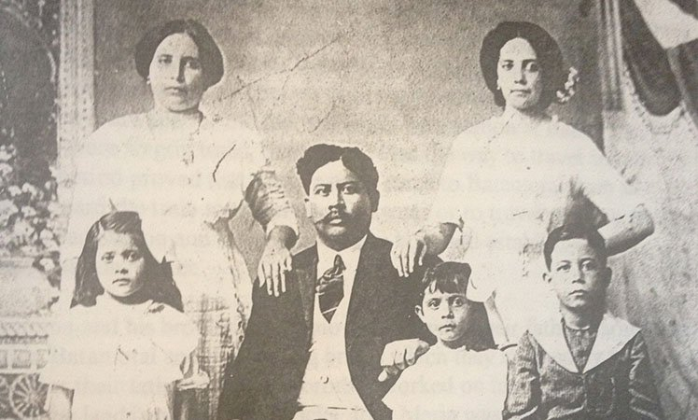



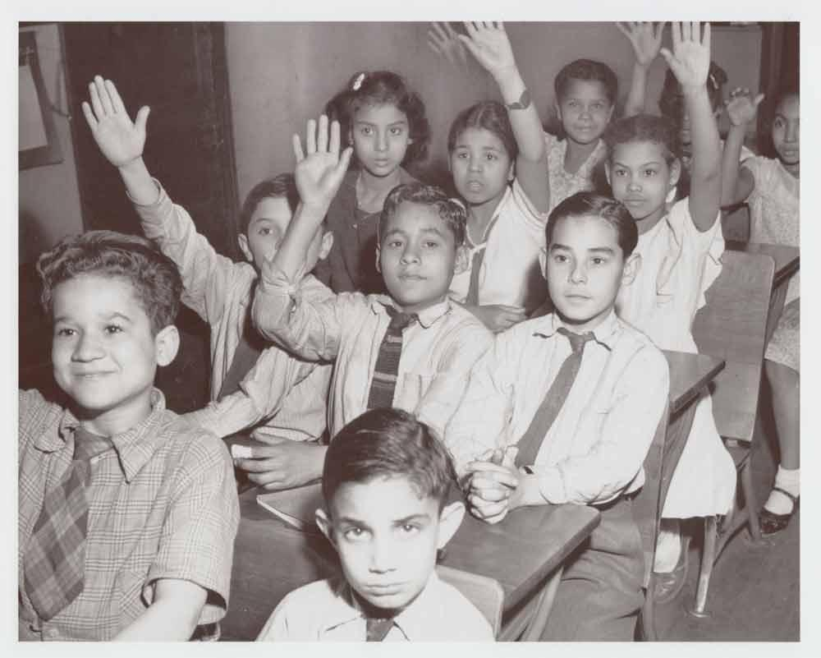
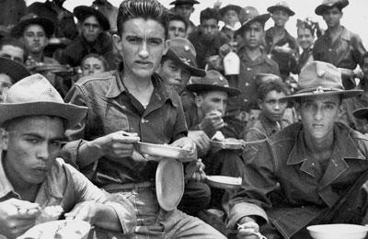
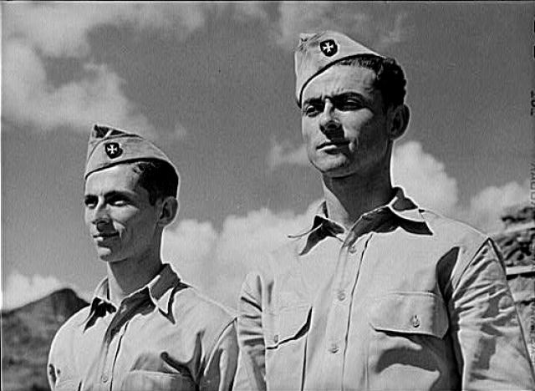
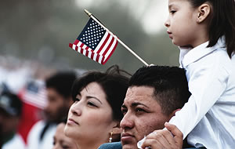
National Hispanic Heritage Month
11

Slide 12
National Hispanic Heritage Month
12
“From the earliest days of our Republic, Hispanic Americans have written crucial chapters in our national story. Hispanics have honorably defended our country in war and built prosperity during times of peace. They run successful businesses, teach our next generation of leaders, and pioneer scientific and technological breakthroughs. This month, America acknowledges these vital contributions and celebrates our Hispanic heritage.”
—President Barack Obama
Presidential Proclamation 2013

Slide 13
Resources
13
http://www.army.mil/hispanicamericans/english/profiles/benavidez.html
http://www.defense.gov/specials/reagan/reaganphotoessay/pinning_3.html
http://www.nsf.gov/nsb/members/bio.jsp?pers=24758
http://www.reaganlibrary.gov/archives/photographs
http://www.nsf.gov/nsb/members/bio.jsp?pers=24758
http://www.census.gov/newsroom/releases/archives/facts_for_features_special_editions/cb13-ff19.html
http://www.whitehouse.gov/the-press-office/2013/09/13/presidential-proclamation-national-hispanic-heritage-month-2013
http://www.pbs.org/latino-americans/en/

Slide 14

Defense Equal Opportunity
Management Institute
September 2014
Dawn W. Smith
Production Development Specialist
DEOMI Research Directorate
Patrick AFB, Florida
All photographs are public domain and are from various sources, as cited.
The findings in this report are not to be construed as an official DEOMI, U.S. military services, or Department of Defense position, unless designated by other authorized documents.
14

